Slide 1

Sales prophesy in business using ml

Slide 2

Team members
Ravi Rajan T
Sarbash Biswas
Vikashini TP
Sailendri GR

Slide 3

abstract
by Unknown author is
Predicting the sales using the data that collected for Black Friday event .Here it is about product but this can help to analysis the interests of the people.

Slide 4

objective
Predicting how much products are sold and the price with different categories with respect to the age and gender .
Finding the categories which has highest sales or interest may help to improve that particular category with new innovation.

Slide 5
Existing system
The system that exists predicts in profit categories and helps gain more products on that category.
Here the prediction done in product category gives more flexibility in product range or varieties to improve.

Slide 6
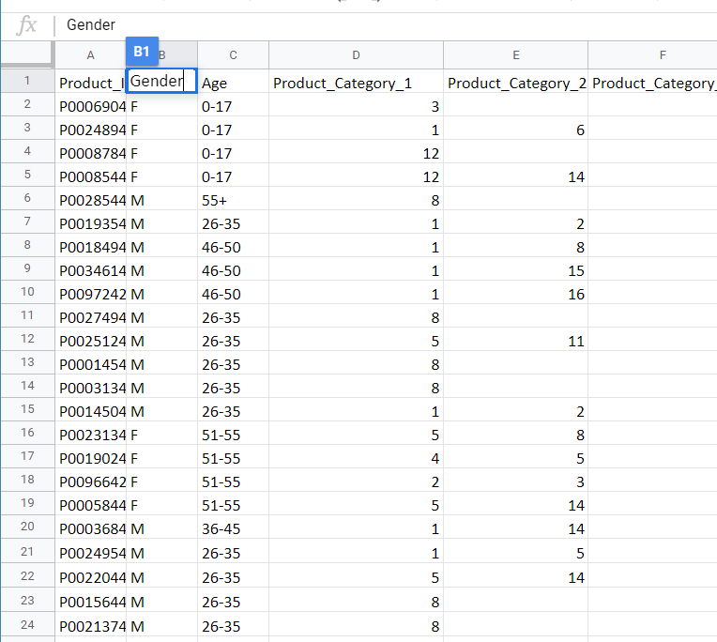
Data used
There are three categories of product in this datasets include some features that are base to it.
Product ID is like a particular product like a smartphones there are mid-range , value-flagship and true-flagship are the categories.

Slide 7
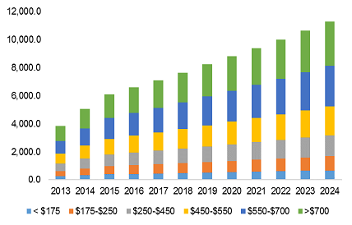
Data used
There are categories here based on the price at the bottom.
The price range above 700 dollars are flagship .
Price range between 450-700 dollars are value flagship.
Less than 450 are considered as mid-rage on todays standards.

Slide 8
limitations
The product category should be categorized properly .
Improper categorization will not give a proper prediction

Slide 9
Proposed System
It can be used in getting the interests of the people in several products in different categories.
Smartphone market can predict the features that people are more interested or helps to bring new advancements

Slide 10
Architecture
Data
Python
Kernel
CPU

Slide 11
List of modules
Get Data
Prepare Data
Manipulate Data
Train model
Test Data
Improve Data

Slide 12
Linear regression
Multiple Linear Regression. Multiple linear regression attempts to model the relationship between two or more explanatory variables and a response variable by fitting a linear equation to observed data. Every value of the independent variable x is associated with a value of the dependent variable y.
Here the x is consists of age and gender and y is the categories of the each product ID.

Slide 13
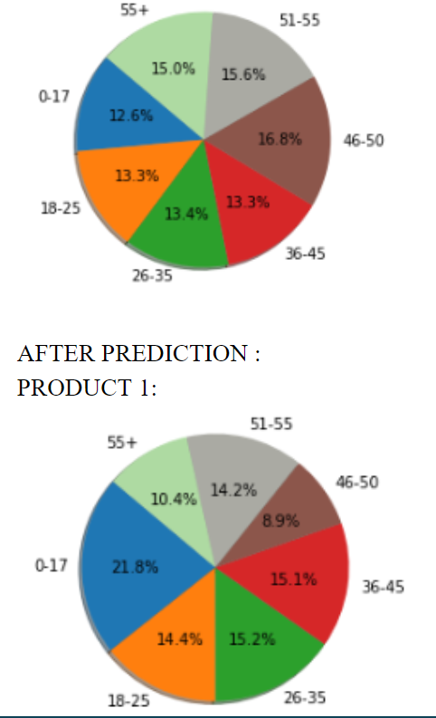
visualization
The difference between the pie chart in product 1 changes for different age groups with repect to their interests.
This can be used to find the higher interests in a category for a particular age groups.

Slide 14
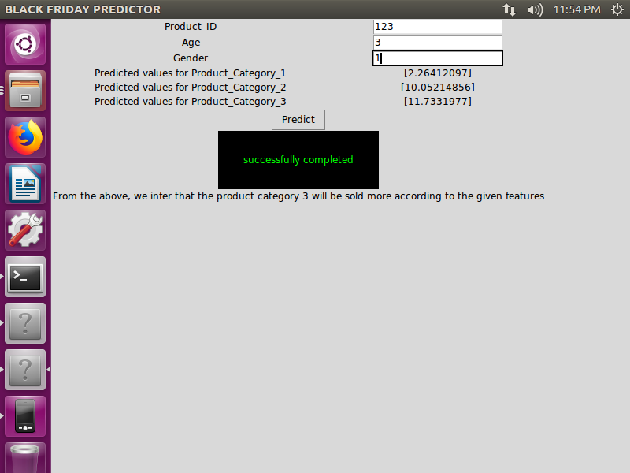
GUI for prediction
In this we can give the attributes to know for that attribute which product category has higher interest.
This data entered will run in the code and shows the predicted value for each product category.

Slide 15
conclusion
Finally this shows the people in different age groups has a different needs and using this we can not only find the category sells the more but also can predict the increase in a particular category and also the interests that made the growth of the category.This can help to come up with intuitive approach.

